Slide 1
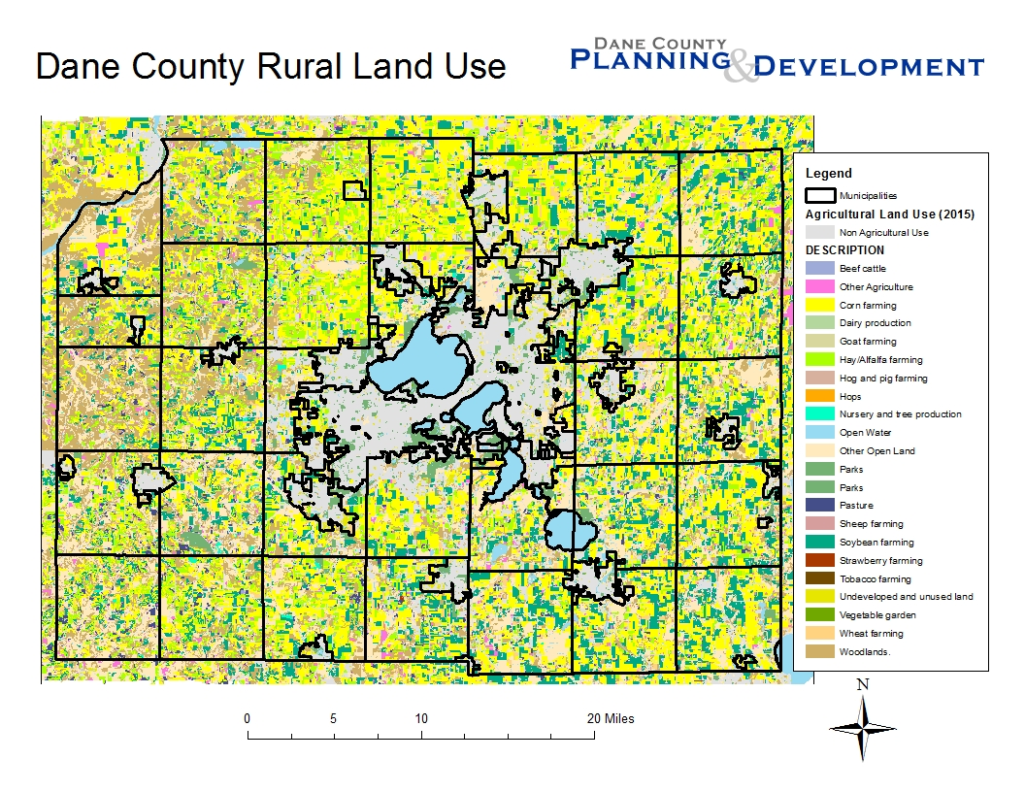

Slide 2
Dane County Farmland Preservation Plan Planning Areas
Farmland Preservation Areas
Based on town plans
Non-Farm Planning Areas
Rural Development / Transitional (based on town plans)
Urban Service Areas (as approved in Dane County Water Quality Plan)
Resource Protection Corridor Overlays
Wetlands
Wetland and shoreland buffers (75’)
Floodplains
Slopes over 20%
Other areas identified in town plans
Notes:
Consistent with “Regional Planning Framework” in Dane County Comprehensive Plan / Water Quality Plan
AP-1 / AP-2 further detail in Comp Plan “Ag Preservation”

Slide 3
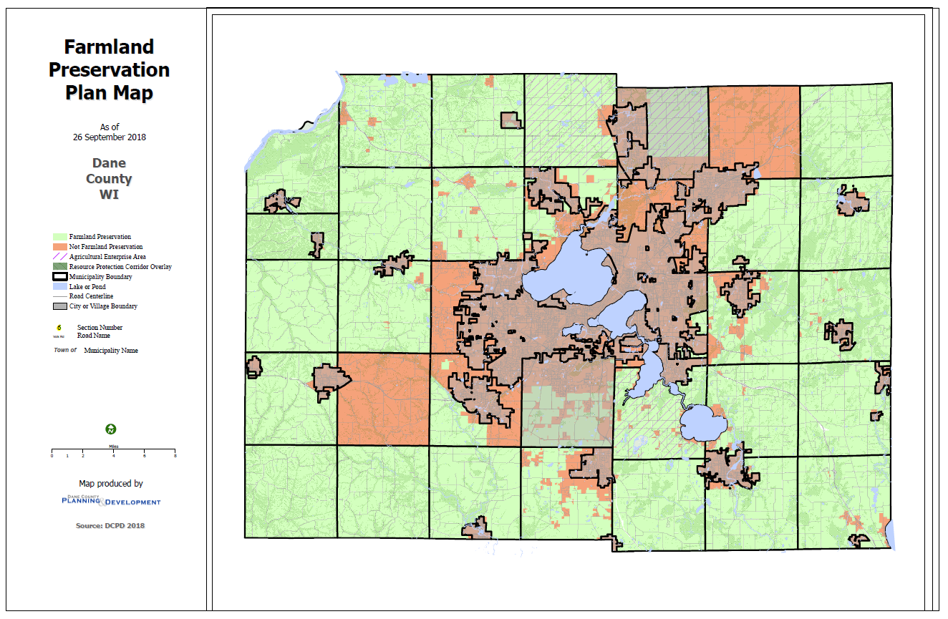
Dane County Farmland Preservation Plan

Slide 4
Dane County Farmland Preservation Plan Programs to Preserve Agriculture
Farmland Preservation Zoning
Density Caps
Siting Criteria
Agricultural Enterprise Areas (AEA)
Purchase of Agricultural Conservation Easements (PACE)
Transfer of Development Rights (TDR)
Economic, Technical Assistance
Notes:
Take credit for things we are already doing
Consider refinements or focusing of existing programs
Take advantage of new state programs, such as PACE grants and AEAs

Slide 5
Dane County Farmland Preservation Zoning
Certified FPZ Districts (current ordinance) | Proposed FPZ Districts (new ordinance) | Notes
A-1(ex) | FP-35 | 35 acres minimum Agriculture, ag accessory uses Farm residences by CUP, with “substantial income” from farm
A-4 | FP-1 | 5 acres minimum (current); 1 acre (new ordinance) Agriculture, ag accessory uses No residences allowed
A-B | FP-B | No minimum lot size Agriculture, ag accessory uses Agriculture-related uses Farm residences by CUP, with “substantial income” from farm
Notes:
Dane County Comprehensive Plan supports zoning ordinance amendments that would “…make it easier to establish agricultural service and other industries that promote appropriate, sustainable rural and farm economic development….”
A-3 zoned areas would lose farm tax credits, but would not have to pay $1,000/acre conversion fees when rezoning for development.

Slide 6
Dane County Farmland Preservation Plan Density Caps
Adopted in most town comprehensive plans
Also adopted by county board as part of Dane County Comprehensive Plan.
Sets limit on number of times a landowner can rezone and divide for non-farm use, based on acres owned as of a specified date.
Limits range by town:
1 home per 35 acres (most common)
1 home per 40 acres
1 home per 75 acres
Sliding scale between 1:25, 1:17 & 1:14, based on nature of development (Town of Springdale only)

Slide 7
Dane County Farmland Preservation Plan Siting Criteria for Nonfarm Development
Based on criteria in most town comprehensive plans
Rezone minimum area necessary for nonfarm use
Avoid:
Wetlands, floodplains, slopes > 20%
Group I & II LESA soils

Slide 8
Dane County Farmland Preservation Plan Purchase of Agricultural Conservation Easements
Federal Farm and Ranchland Protection Program
State PACE grants
Funding eliminated in 2011
Program authorization remains
Existing County Programs
Parks & Open Space Plan / County Conservation Fund
Land & Water Legacy Fund
Matching grants to local governments
Limited PACE / PDR (funding dependent)
Policy guidance for future PACE programs included in FPP
Local Programs
Town of Dunn
Town of Windsor

Slide 9
Dane County Farmland Preservation Plan Transfer of Development Rights
County ordinance adopted 2010
Model town plan language
Program guidance included in Farmland Preservation Plan
Operational Programs
Town of Albion
Town of Berry (town zoning)
Town of Cottage Grove
Town of Cross Plains
Town of Dane
Town of Mazomanie
Town of Pleasant Springs
Town of Rutland
Town of Springfield (town zoning)

